Slide 1
2010 Alaska Marine Science Symposium Ocean Acidification Adaptation, Research and Communication
Workshop Overview
18 January 2010
0900-1200

Slide 2
Conveners
Ian M. Dutton, Alaska SeaLife Center and NPRB,
Jeremy Mathis, School of Fisheries and Ocean Sciences, UAF SFOS,
Nora Deans, NPRB + COSEE Alaska,
Marilyn Sigman, COSEE Alaska
Molly McCammon, AOOS + COSEE Alaska

Slide 3
Objectives
Provide AMSS attendees with an overview of current knowledge of Ocean Acidification in the North Pacific
Develop guidance for:
Researchers (and research funders) on OA research priorities in Alaska
Educators on OA communication best practices; and
Managers and communities on OA adaptation principles and practices to test and learn from

Slide 4
Overview Presentations 0900-0945
Richard Feely, PMEL, NOAA; Jeremy Mathis, UAF-SFOS – 30 mins
Current state of knowledge about OA in North Pacific
Carin Bailey Stephens, UAF-SFOS – 5 mins
Communicating OA – initial experiences in Alaska
Ian Dutton, ASLC and Jeff Short, Oceana – 5 mins
Adaptation opportunities and directions

Slide 5
Breakout Sessions 0950-1125
Research priorities – this room
Jeremy Mathis and Dick Feely
Adaptation Principles – Club Room 1 (10th floor)
Ian Dutton and Jeff Short
Communication - Club Room 2 (10th floor)
Carin Bailey Stephens and Marilyn Sigman

Slide 6
Plenary Reporting (this room) 1130-1200
5 mins from each break out
Group Q+A
Overview of next steps
Production and posting of workshop report
Formation of discussion group within COSEE?

Slide 7
Adaptation Session

Slide 8
Adaptation – a general defintion
Adaptation: Adjustment in natural or human systems in response to actual or expected climatic changes or their impacts, so as to reduce harm or exploit beneficial opportunities.

Slide 9
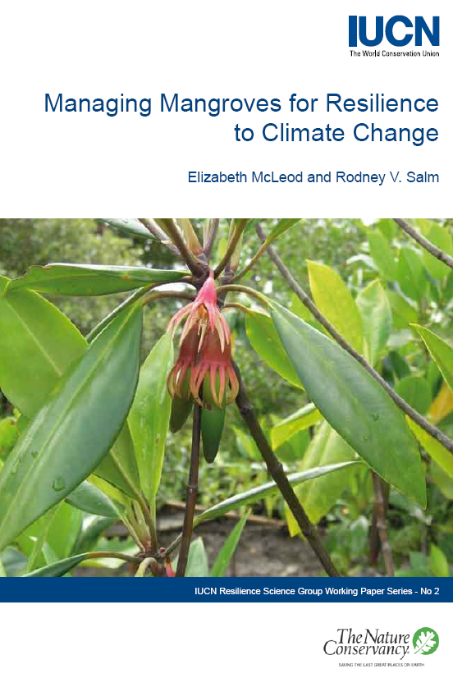
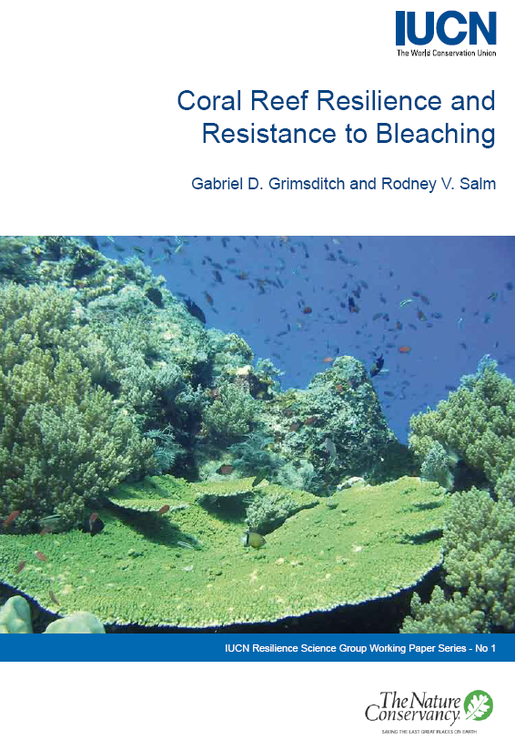
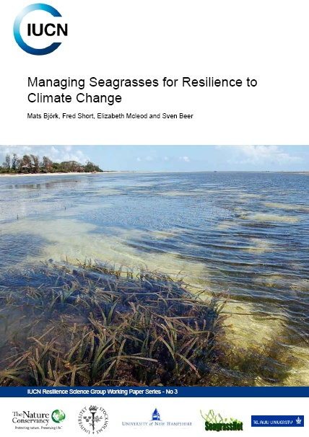
IUCN Resilience Series

Slide 10
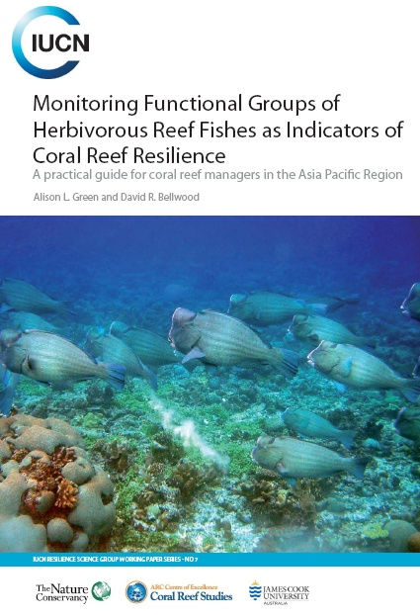
Leading to New Science Tools

Slide 11
… and Management Theory
Salm et al 2009. Coral Reefs and Climate Change: Science and Management, Coastal and Estuarine Studies 61: 207-222.

Slide 12
Managing Mangroves for Resilience to Climate Change: 10 Strategies
1) Apply risk-spreading strategies to address the uncertainties of climate change.
Identify and protect critical areas that are naturally positioned to survive climate change.
Manage human stresses on mangroves.
Establish greenbelts and buffer zones to allow for mangrove migration in response to sea-level rise, and to reduce impacts from adjacent land-use practices.
Restore degraded areas that have demonstrated resistance or resilience to climate change.
Understand and preserve connectivity between mangroves and sources of freshwater and sediment, and between mangroves and their associated habitats like coral reefs and seagrasses.
Establish baseline data and monitor the response of mangroves to climate change.
Implement adaptive strategies to compensate for changes in species ranges and environmental conditions.
Develop alternative livelihoods for mangrove dependent communities as a means to reduce mangrove destruction.
Build partnerships with a variety of stakeholders to generate the necessary finances and support to respond to the impacts of climate change.
http://data.iucn.org/dbtw-wpd/edocs/2006-041.pdf

Slide 13
Managing Mangroves for Resilience to Climate Change: 10 Strategies
Improve management to reduce human impacts and to maintain seagrasses in as healthy a condition as possible and so better able to resist or recover from stresses, including climate change. There is no substitute for effective management and good water quality to enhance seagrass resilience.
b) Develop baseline maps of seagrass meadows to allow for monitoring of changes in distribution and abundance.
c) Implement monitoring programmes (e.g. SeagrassNet) that provide feedback on the results of coastal management. If management strategies are not meeting their objectives, they need to be adapted to achieve their goals.
d) Identify and fully protect seagrass communities that are at low risk of succumbing to climate change and anthropogenic impacts because these seagrass communities will serve as refugia to help seed the recovery of damaged areas.

Slide 14
Managing Mangroves for Resilience to Climate Change: 10 Strategies
e) Reduce the risk of any seagrass communities being lost as a consequence of climate change impacts by protecting multiple samples of the full range of seagrass communities and from a wide geographical range.
f) Identify patterns of connectivity between seagrass beds and adjacent habitats, e.g. mangroves and coral reefs, to improve the design of marine protected area networks and allow for ecological linkages and shifts in species distribution.
g) Restore critical seagrass areas that are positioned to survive climate change impacts by eliminating the causative agents of their decline.
h) Raise awareness of the value and threats to seagrasses, ensuring that coastal zone management or land use policies and plans address potential impacts to seagrasses and implement codes of conduct for fishing and boat anchoring to reduce disturbances.
http://data.iucn.org/dbtw-wpd/edocs/2008-024.pdf

Slide 15
Lots of Emerging Adaptation Guidance

Slide 16
So what are some adaptation principles relevant to Alaska?
Brainstorm
Categorize
Recommend next steps

